Slide 1


Brought to you by overgram.co

Slide 2
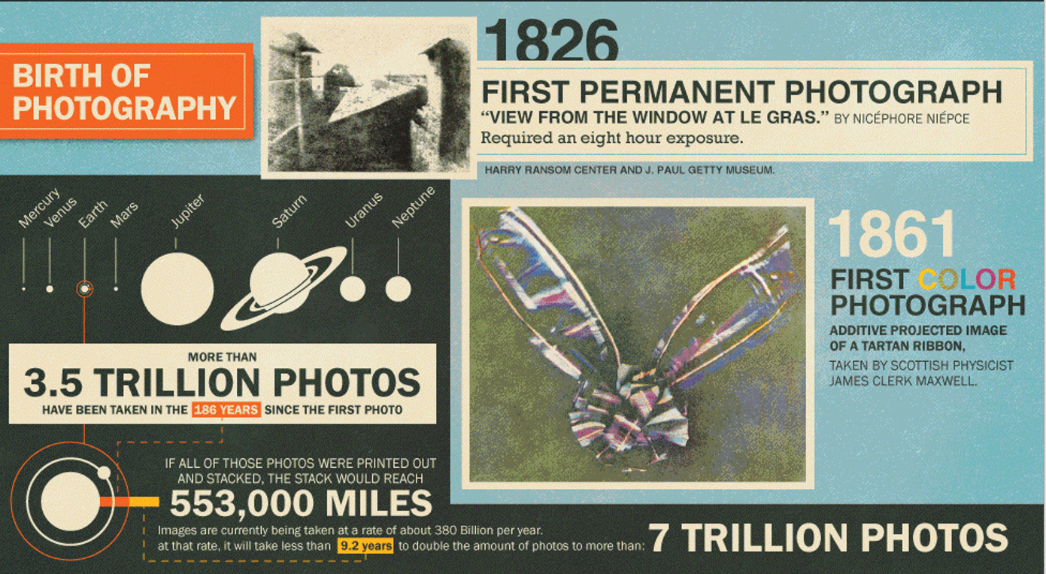

Slide 3
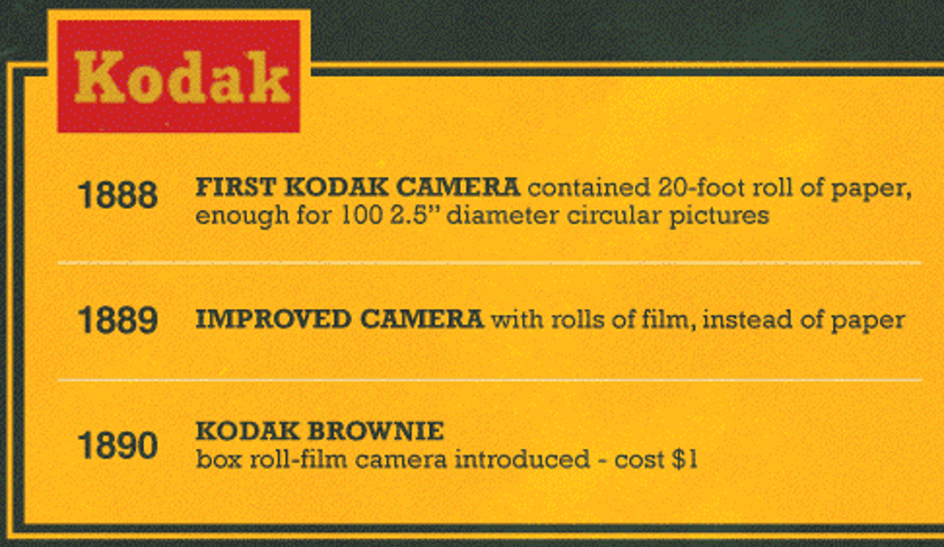
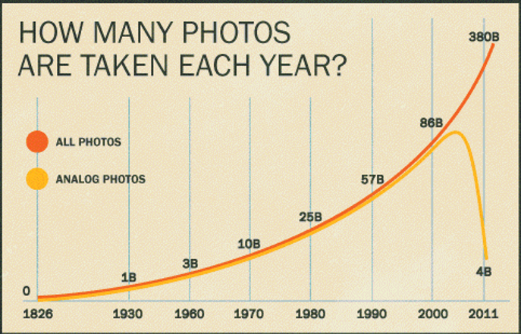
1878
HIGH-SPEED
PHOTOGRAPH
TAKEN BY EADWEARD MUYBRIDGE
USING A SERIES OF TRIP WIRES

Slide 4
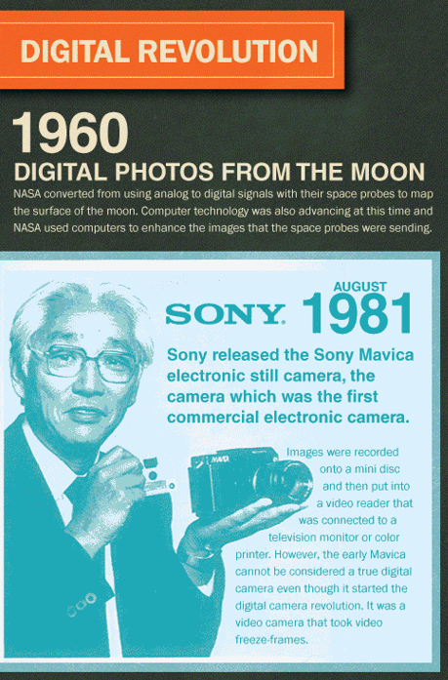
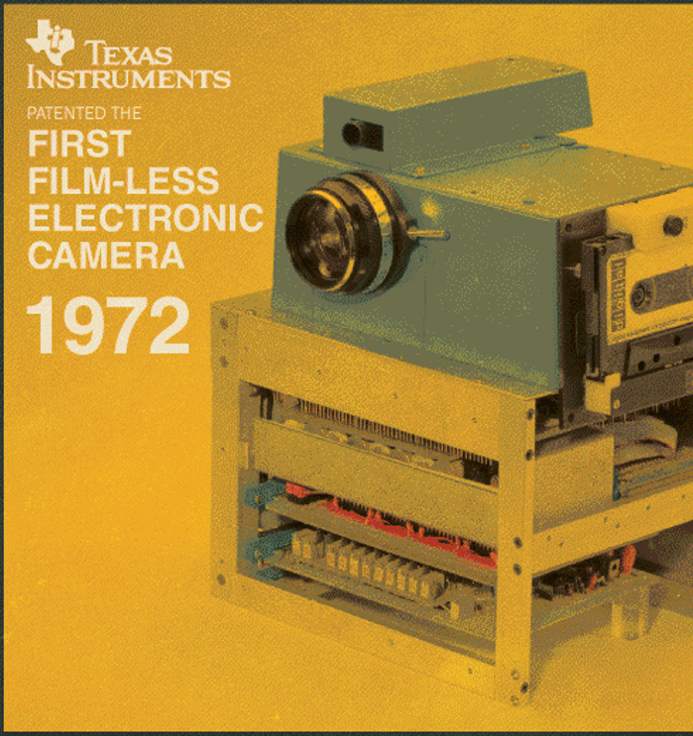

Slide 5
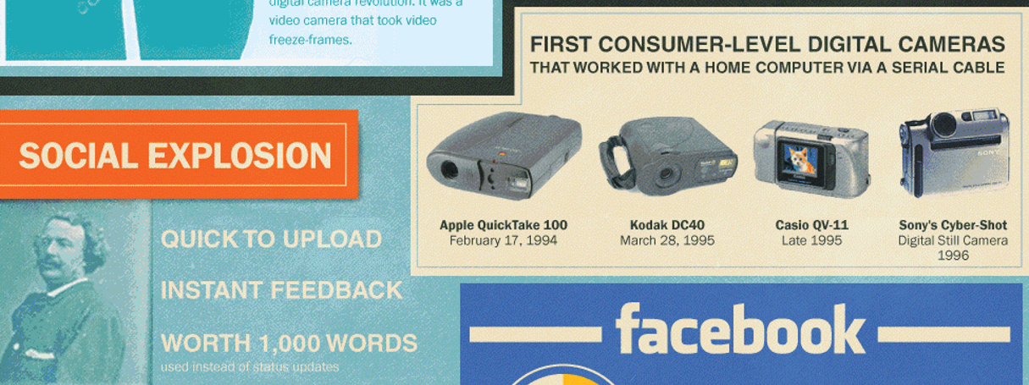

Slide 6



Slide 7


Slide 8
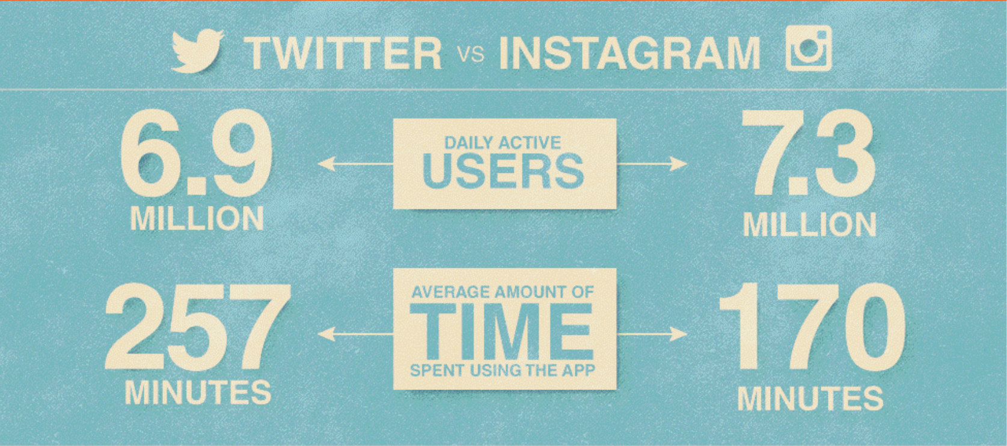
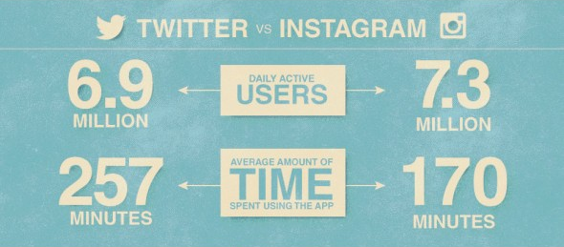

Slide 9




Slide 10
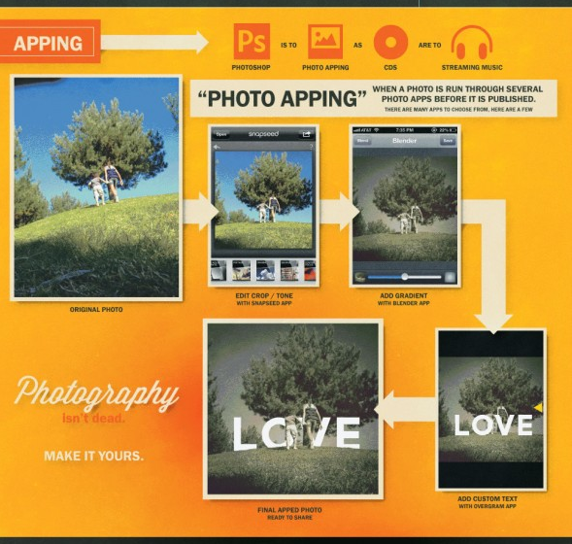
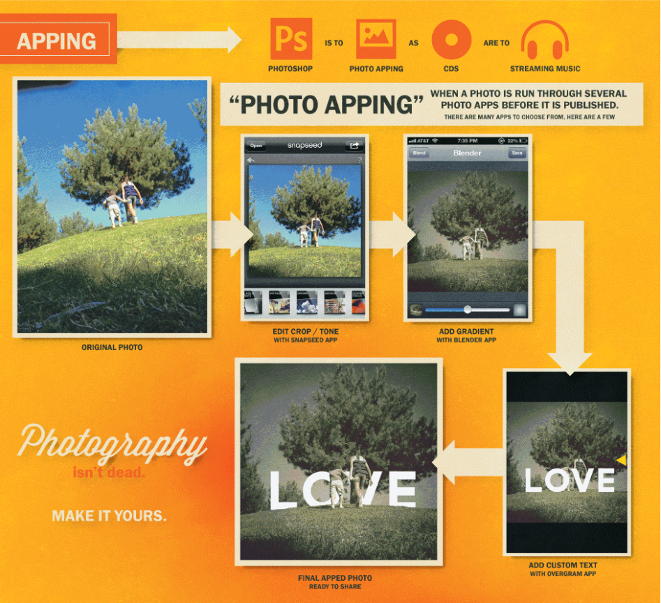

Slide 11


All copyrights of the images and all other elements used in this presentation are reserved with the original author.

Slide 12
